Slide 1
Dynamic Model Builders
Scrum 3
Department of Chemical and Biomolecular Engineering

Slide 2
Progress
Code runs on Titan
4 second run time (Using PGI C++ Compiler) for a single simulation (700 species, 2700 reactions)
Implicit solver but system is not stiff
Profiled the code to find hot spots
40% load in the LU decomposition

Slide 3
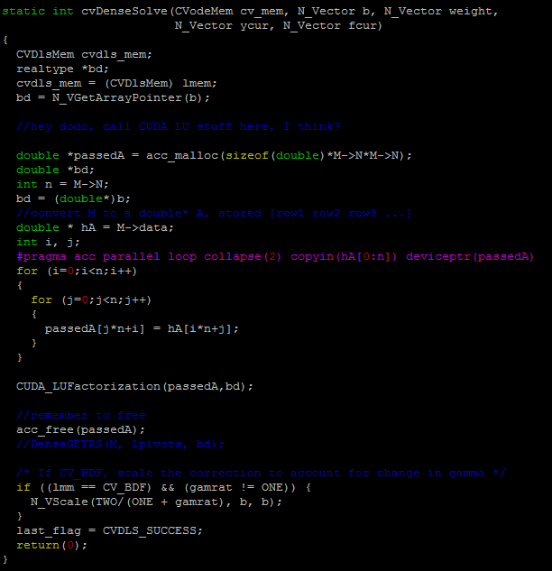
Parallelization Attempts
Attempt 1: Open ACC
CVODEs LU Decomposition did not parallelize well
Attempt 2: CUDA LAPACK LU Decomposition
Problem with CUDA toolkit module

Slide 4
Parallelization Attempts
Attempt 3: SuperLU Decomposition
CUDA
OpenMP
Currently attempting to port to Titan

Slide 5
Thanks!

